Slide 1
Chapter 12
System build, implementation
and maintenance: change
management

Slide 2
Learning objectives
After this lecture, you will be able to:
  state the purpose of the build phase, and its difference from changeover and implementation;
  specify the different types of testing required for a system;
  select the best alternatives for changing from an old system to a new system;
  recognise the importance of managing software, IS and organisational change associated with the introduction of a new BIS.

Slide 3
Management issues
From a managerial perspective, this chapter addresses the following questions:
  How should the system be tested?
  How should data be migrated from the old system to the new system?
  How should the changeover between old and new systems be managed?
  How can the change to a process-oriented system be managed?

Slide 4
System build and implementation
System build: The creation of software by programmers involving programming, building release versions of the software and testing by programmers and end-users. Writing
of documentation and training may also occur at this stage.
System implementation: Involves the transition or changeover from the old system to the new and the preparation for this such as making sure the hardware and network infrastructure for a new system are in place; testing of the system and also human issues of how best to educate and train staff who will be using or will be affected by the new system.
Maintenance: Deals with reviewing the IS project and acting on problems with the system.
Change management: The period of migration from existing systems to a new system.

Slide 5
Software quality
The quality of software is dependent on two key factors:
  the number of errors or bugs in the software;
  the suitability of the software to its intended purpose, i.e. does it have the features identified by users which are in the requirements specification?

Slide 6
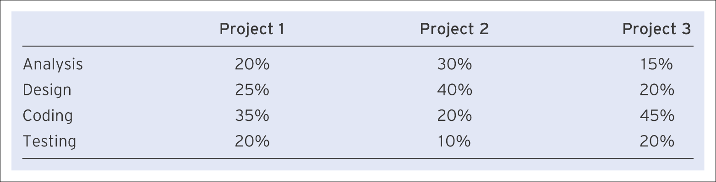
Examples of source of introducing errors
Table 12.1 Table comparing the source of errors in three different software projects

Slide 7
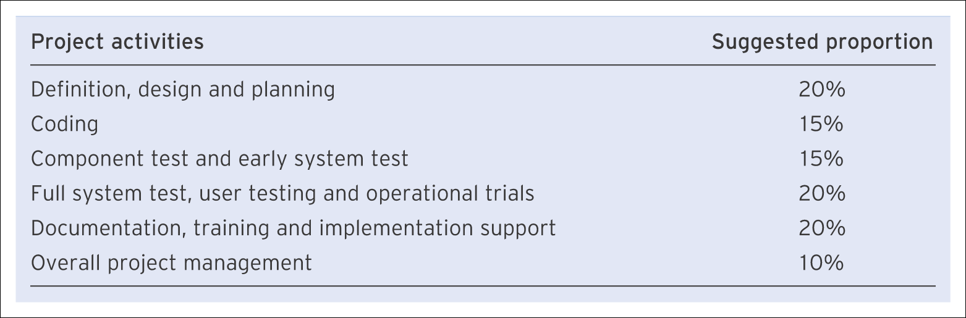
Ideal proportions of time for different project phases
Table 12.2 Ideal proportions of time to be spent on different phases of a systems development project, focusing on details of build phase

Slide 8
Data migration
Data migration: Data migration is the transfer of data from the old system to the new system. When data are added to a database, this is known as populating the database.
Import and export: Data can be ‘exported’ from an old system and then ‘imported’ into a new system.

Slide 9
Testing
Test specification: A detailed description of the tests that will be performed to check the software works correctly.
Test plan: Plan describing the type and sequence of testing and who will conduct it.

Slide 10
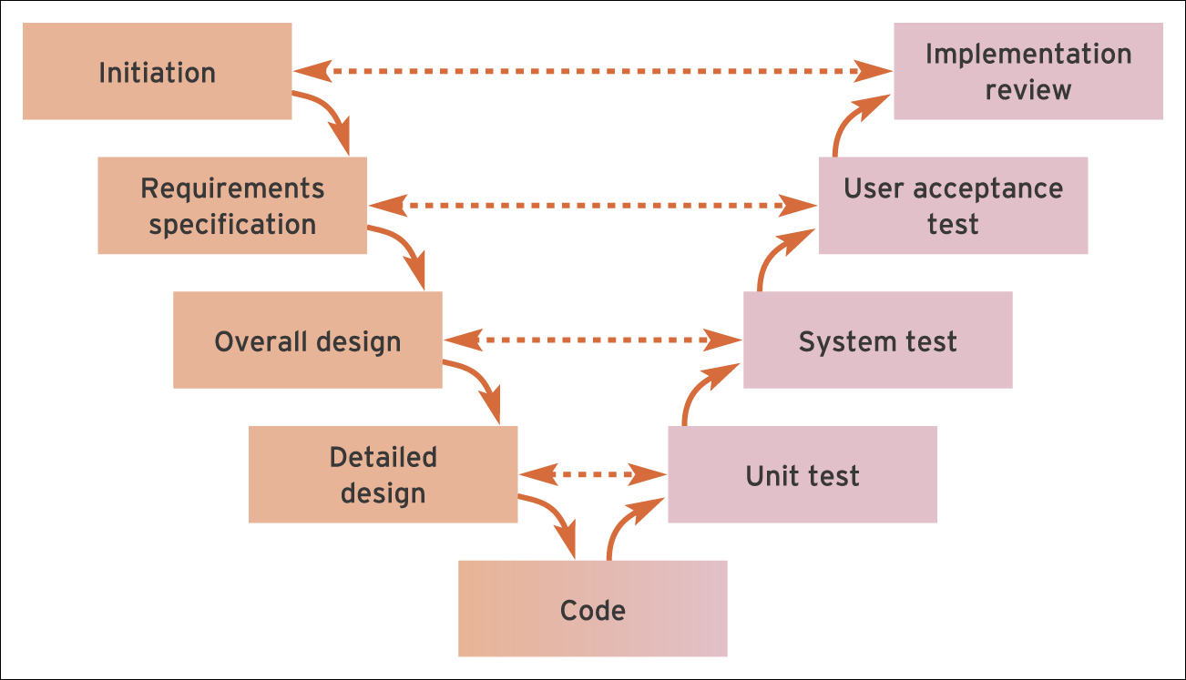
Figure 12.1 The V-model of systems development relating analysis and design activities to testing activities

Slide 11
Maintenance
Maintenance: Maintenance occurs after the system has been signed off as suitable for users. It involves reviewing the project and recording and acting on problems with the system.

Slide 12
Post-implementation review
Post-implementation review: A meeting that occurs after a system is operational to review the success of the project.
The review could include the following:
  faults and suggested enhancements with agreement on which need to be implemented in a future release;
  success of system in meeting its budget and timescale targets;
  success of system in meeting its business requirements – has it delivered the anticipated benefits described in the feasibility study?
  development practices that worked well and poorly during the project.

Slide 13
Change management
The main activities undertaken by a manager of systems development projects are essentially concerned with managing change. Managing change takes different forms.
1. Software change management
  Managing technical changes to the software requirements as the system is developed through prototyping and testing.
2. Information system change management
  How organisations can manage the transition or changeover to a new information system from an old system.
3. Organisational change management
  How the introduction of a new system can affect the business users and action that can be taken to manage this organisational change. The role of organisational culture in influencing this will also be considered.

Slide 14
1. Software change management
At each stage of a systems development project, change (modification) requests or variations to requirements will arise from business managers, users, designers and programmers. These requests include reports of bugs and of features that are missing from the system as well as ideas for future versions of the software.
These requests will occur as soon as users start evaluating prototypes of a system and will continue through to the maintenance phase of the project when the system has gone live. As the users start testing the system in earnest in the implementation phase, these requests will become more frequent and tens or possibly hundreds will be generated each week. This process of change needs to be carefully managed, since otherwise it can develop into requirements creep, a problem on many information systems projects.

Slide 15
Configuration management
Throughout the implementation phase, updated versions of the software are released to users for testing. Configuration management is control of the different versions of software and program source code used during the build, implementation and maintenance phases of a project.
Alpha release: Alpha releases are preliminary versions of the software released early in the build process. They usually have the majority of the functionality of the system in place, but may suffer from extensive bugs.
Alpha testing: The purpose of ‘alpha testing’ is to identify bugs and any major problems with the functionality and usability of the software. Alpha testing is usually conducted by the staff inside the organisation developing the software or by favoured customers.
Beta release: Beta releases occur after alpha testing and have almost complete functionality and relatively few bugs.

Slide 16
2. Information system change management
Choosing the method to be used for migrating or changing from the old system to the new system is one
of the most important decisions that the project management team must make during the implementation phase.
Changeover can be defined as moving from the old information system to the new information system.
There are four main alternatives for moving from a previous system to a new system. The options are shown in Figure 12.2.

Slide 17
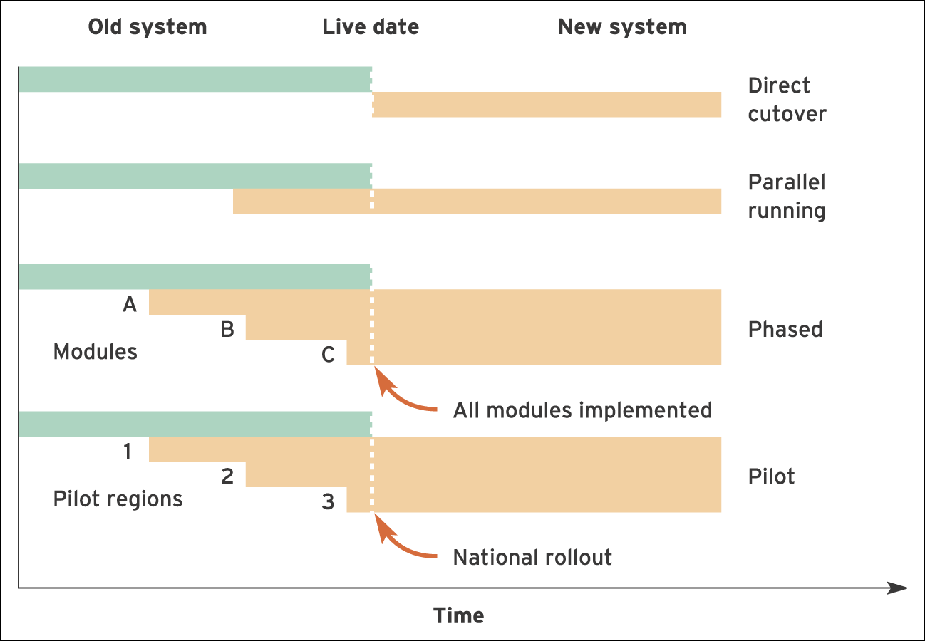
Figure 12.2 Alternative changeover methods for system implementation

Slide 18
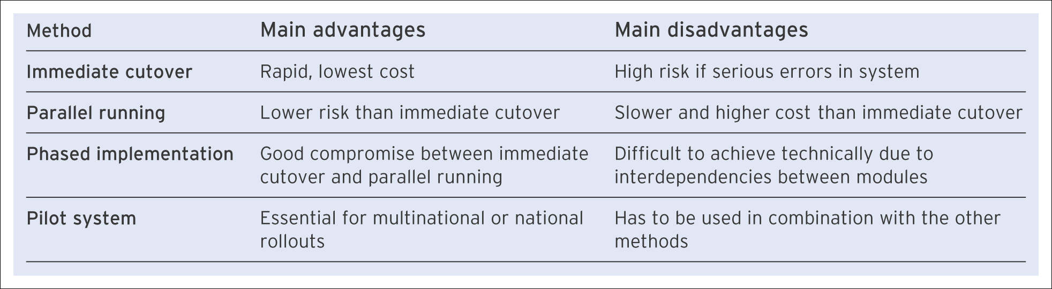
Assessing different changeover methods
Table 12.4 Advantages and disadvantages of the different methods of implementation

Slide 19
3. Organisational change management
This deals with managing changes to organisational processes, structures and their impact on organisational staff and culture.
Business process management:
  An approach supported by software tools intended to increase process efficiency by improving information flows between people as they perform business tasks.
Incremental change:
  Relatively small adjustments required by an organisation in response to their business environment.
Discontinuous change:
  Change involving a major transformation in an industry.

Slide 20
Degrees of change
Business process re-engineering (BPR):
      Identifying radical, new ways of carrying out business operations, often enabled by new IT capabilities
Business process improvement (BPI):
      Optimising existing processes typically coupled with enhancements in information technology.
Business process automation (BPA):
  Automating existing ways of working manually through information technology.

Slide 21
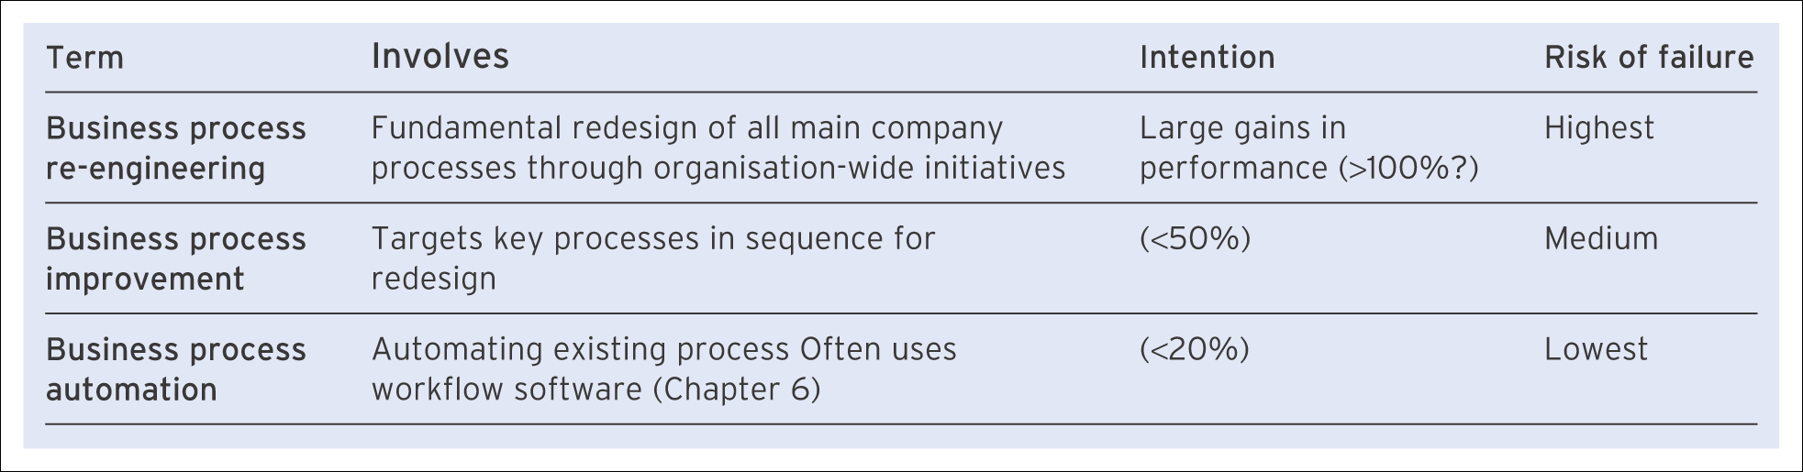
Alternative terms for using IS to enhance company performance
Table 12.5 Alternative terms for using IS to enhance company performance

Slide 22
Business process management
Business process management (BPM) is an important approach to process management that can be considered both in terms of a philosophy towards process change and as a supporting technology to process change in the form of tools for process design.
The philosophy of BPM recognises that business processes, and the way they are managed, are the key mechanisms that allow the organisation to deliver value to its customers. The approach thus entails an analysis of the structure of the organisation, the way people work together and the way technology is utilised.

Slide 23
BPM tools
Process mapping:
  The use of a flowchart to document the process incorporating process activities and decision points.
Business process simulation:
  The use of computer software, in the context of a process-based change, that allows operation of a business to be simulated.
Business activity monitoring (BAM)
  Software that is designed to monitor, capture and analyse business performance data in real time and present them visually in order that rapid and effective decisions can be taken.

Slide 24
Service-oriented architecture (SOA)
The concept of SOA is to develop a number of reusable business aligned IT services that span multiple applications across the organisation.
SOA defines the services in such a way as to be utilised in a manner that is independent of the underlying application and technology platforms.
The advantage of this approach for business process management is that a business process can link with the business services which are activated by the business processes without the need to know about the underlying application and technology platforms
The term web services is the technology which is most associated with the formation of a service-oriented architecture.

Slide 25
Achieving organisational change
Implementation of processes that are performed by employees requires consideration of organisational change management including factors such as managing a change in culture.
An essential part of managing change associated with IS introduction is education to communicate the purpose of the system to the staff. It involves:
  explaining why the system is being implemented;
  explaining how staff will be affected;
  treating users as customers by involving them in specification, testing and review;
  training users in use of the software;
  above all, listening to users and acting on what they say.

Slide 26
Achieving organisational change (Continued)
Resistance to change may manifest itself in the following ways:
  Aggression – in which there may be physical sabotage of the system, deliberate entry of erroneous data or abuse of systems staff.
  Projection – where the system is wrongly blamed for difficulties encountered while using it.
  Avoidance – withdrawal from or avoidance of interaction with the system, non-input of data, reports and enquiries ignored, or use of manual substitutes for the system.
Training plays an important role in overcoming resistance to change.

